Slide 1
Lecture 18
Tree Extensions
Notes:
*：不考察

Slide 2
Outline
Huffman Trees
Threaded Binary Trees
Lexicographic Search Trees: Tries*
Splay Trees*

Slide 3
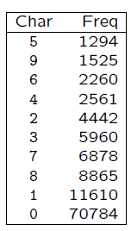
Huffman Coding
Consider the following data, which is taken from a Postscript file.
Notice that there are many more occurrences of 0 and 1 than the other characters.

Slide 4
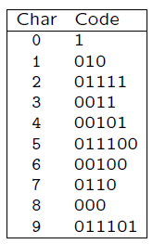
Huffman Coding
What would happen if we used the following code to store the data rather than the fixed length code?
To store the string 0748901 we would get 0000011101001000100100000001 using the fixed length code and 10110001010000111011010 using the variable length code.

Slide 5
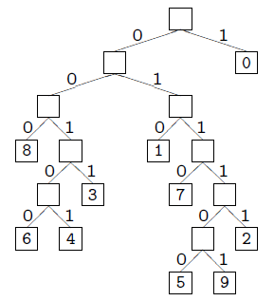
Huffman Tree: Optimal Binary Tree
In order to be able to decode the variable length code properly it is necessary that it be a prefix code — that is, a code in which no codeword is a prefix of any other codeword.
Decoding such a code is
done using a binary tree,
called Huffman tree.

Slide 6
Huffman Coding
Now assign to each leaf of the tree a value, f(c), which is the frequency of occurrence of the character c represented by the leaf.
Let d_{T}(c) be the depth of character c’s leaf in the tree T.
Then the number of bits required to encode a file is
which we define as the cost, or weighted path length (WPL) of the tree T.

Slide 7
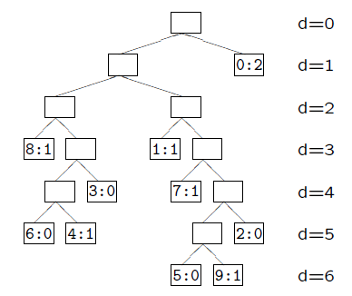
Huffman Coding
For example, the number of bits required to store the string 0748901 can be computed from the tree T:
giving B(T) = 2×1+1×3+1×3+1×4+1×5+1×6 = 23.
Thus, the cost of the tree T is 23.

Slide 8
Huffman Coding
A tree representing an optimal code for a file is always a full binary tree (note, full v.s. complete, perfect) — namely, one where every node is either a leaf or has precisely two children.
Therefore if we are dealing with an alphabet of s symbols we can be sure that our tree has precisely s leaves and s−1 internal nodes, each with two children.
Huffman invented a greedy algorithm to construct such an optimal tree. The resulting code is called a Huffman code for that file.

Slide 9

Huffman’s Algorithm
Huffman’s algorithm: The algorithm starts by creating a forest of s single nodes, each representing one character, and each with an associated value, being the frequency of occurrence of that character. These values are placed into a priority queue (implemented as a linear array).
Then repeat the following procedure s − 1 times:
  Remove from the priority queue the two nodes L and R with the lowest values, and create a internal node of the binary tree whose left child is L and right child R.
  Compute the value of the new node as the sum of the values of L and R and insert this into the priority queue.

Slide 10
Exercise
Given Char = {a, b, c, d, e, f} and Freq = {8, 3, 4, 6, 5, 5}, build the Huffman Tree.

Slide 11
Threaded Binary Trees
A threaded binary tree is a type of binary tree data structure where the empty left and right child pointers in a binary tree are replaced with threads that link nodes directly to their in-order predecessor or successor, thereby providing a way to traverse the tree without using recursion or a stack.
The idea of threaded binary trees is to make inorder traversal faster and do it without stack and without recursion. Threaded binary trees can be useful when space is a concern, as they can eliminate the need for a stack during traversal.
There are two types of threaded binary trees.
  Single Threaded: Where a NULL right pointers is made to point to the inorder successor (if successor exists)
  Double Threaded: Where both left and right NULL pointers are made to point to inorder predecessor and inorder successor respectively. The predecessor threads are useful for reverse inorder traversal and postorder traversal.

Slide 12
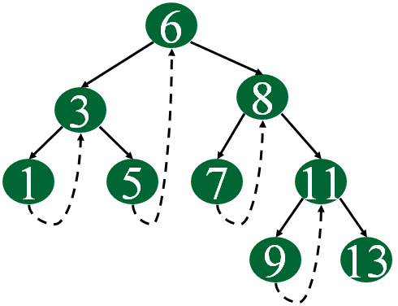
Threaded Binary Trees
Single Threaded
Double Threaded
6
8
3
1
5
7
11
9
13
Inorder: 1 3 5 6 7 8 9 11 13

Slide 13
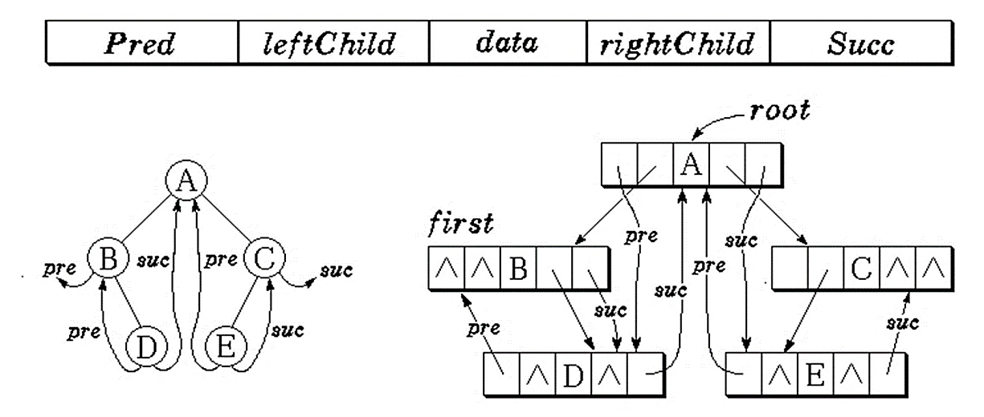
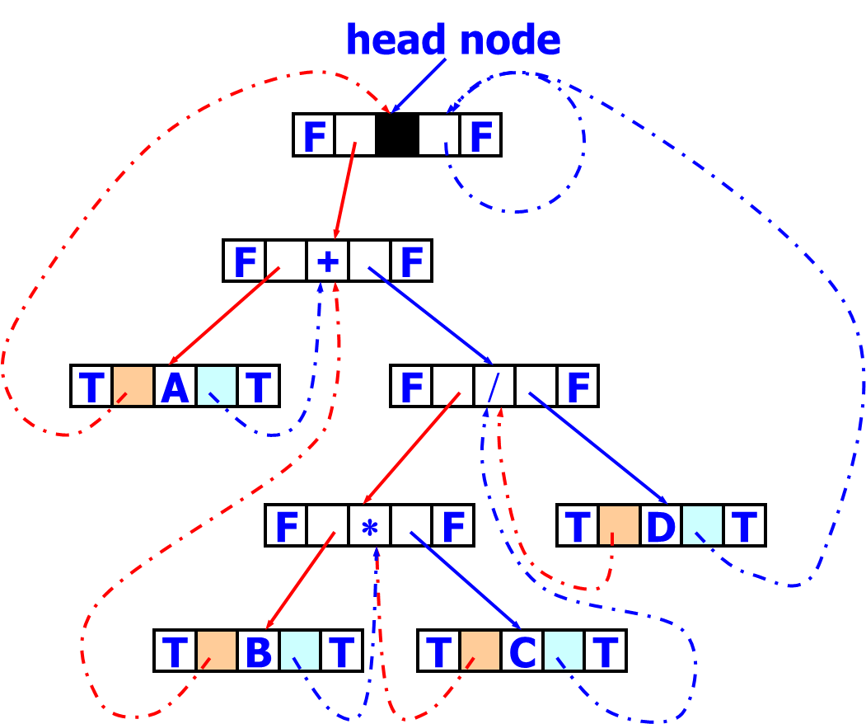
Threaded Binary Trees
Node definition
ltag=0: lchild points to left child
ltag=1: lchild points to predecessor
rtag=0: rchild points to right child
rtag=1: rchild points to successor
Threaded binary tree with head node
ltag
lchild
data
rchild
rtag

Slide 14
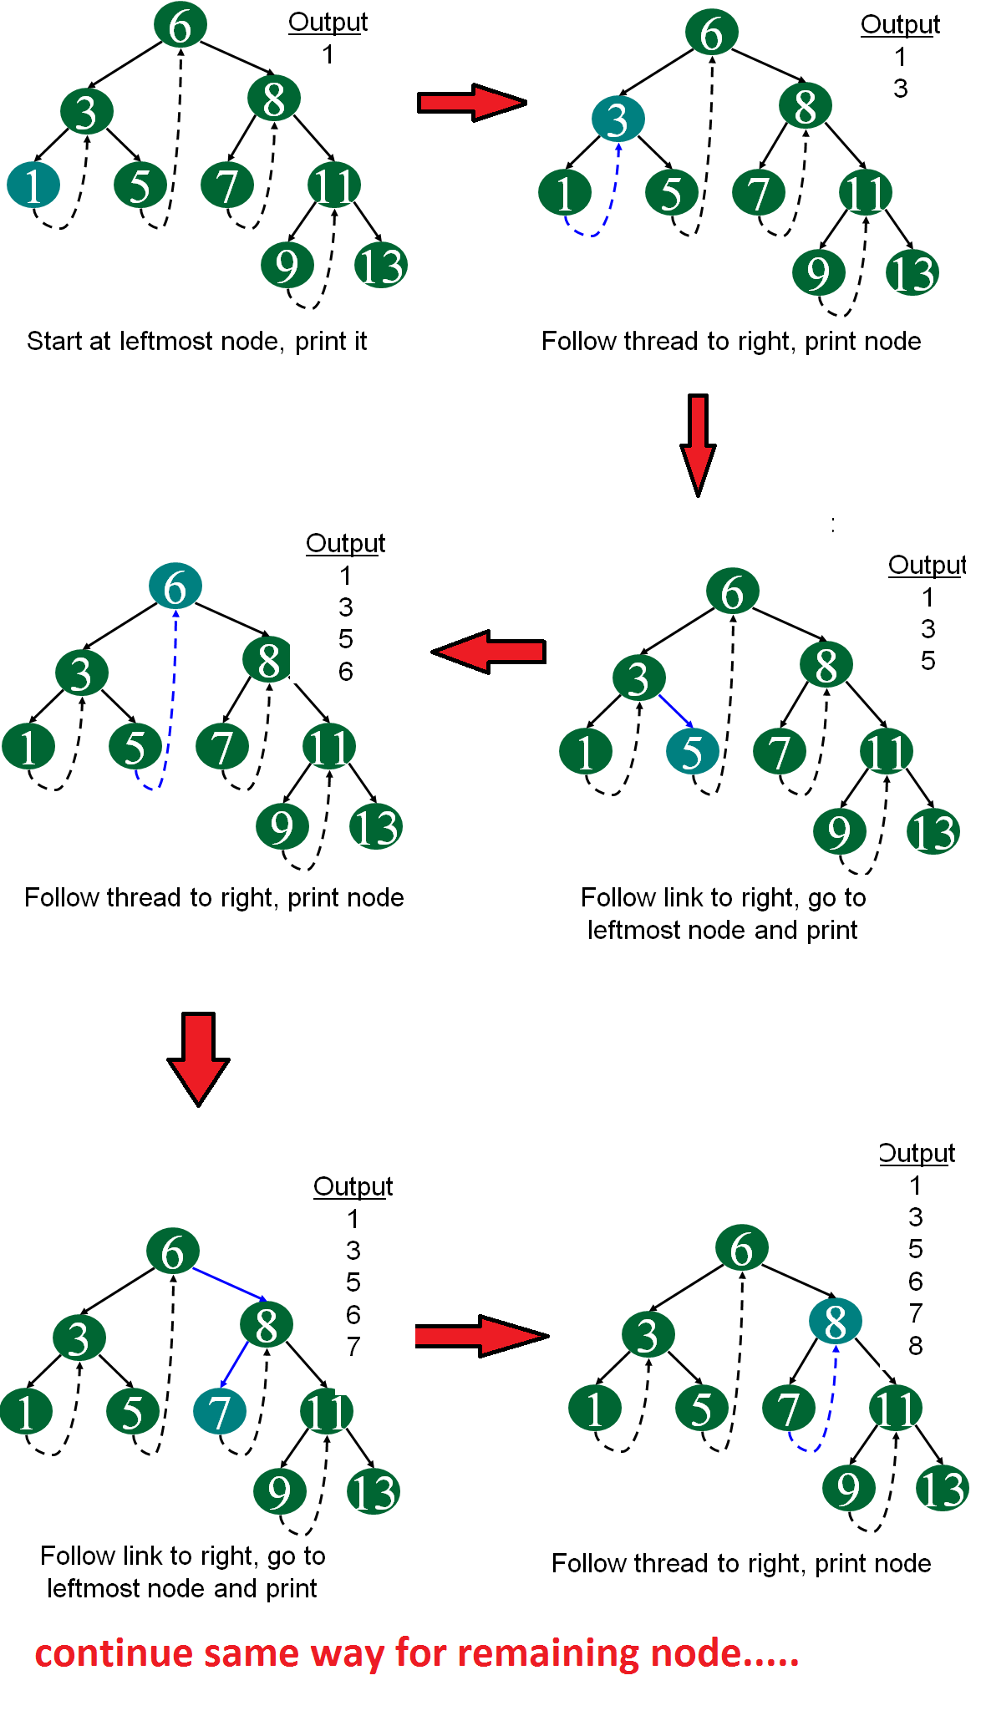
Threaded Binary Tree Traversal
Inorder traversal
  We start at the leftmost node in the tree, print it, and follow its right thread.
  If we follow a thread to the right, we output the node and continue to its right.
  If we follow a link to the right, we go to the leftmost node, print it, and continue.

Slide 15
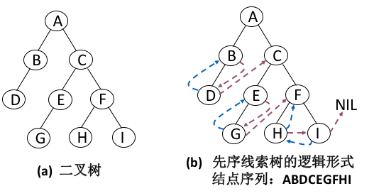
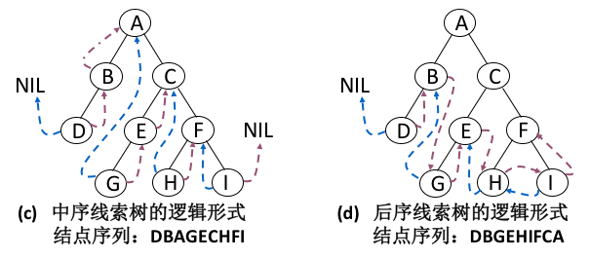
Different Types of Threaded Binary Trees

Slide 16

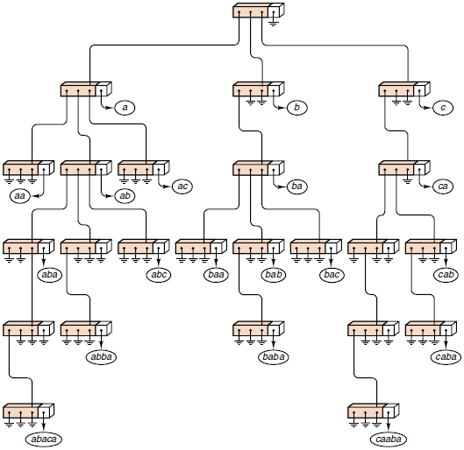
Lexicographic Search Trees: Tries*(字典树)

Slide 17
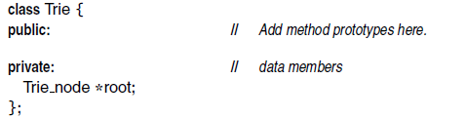
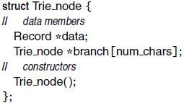
C++ Trie Declarations
The term “trie” originated as letters extracted from the word retrieval, but it is usually pronounced like the word “try”.
Every Record has a Key that is an alphanumeric string.
The constructor sets all pointer members to NULL!

Slide 18
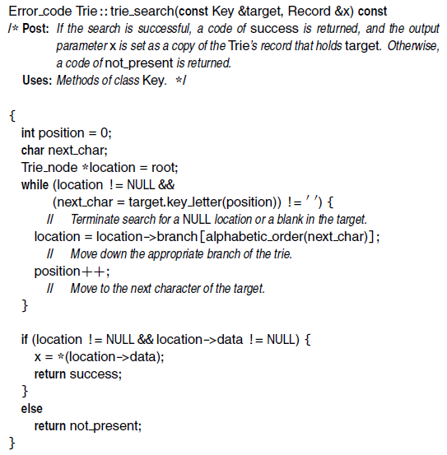
Searching a Trie
Determine which branch to move to

Slide 19
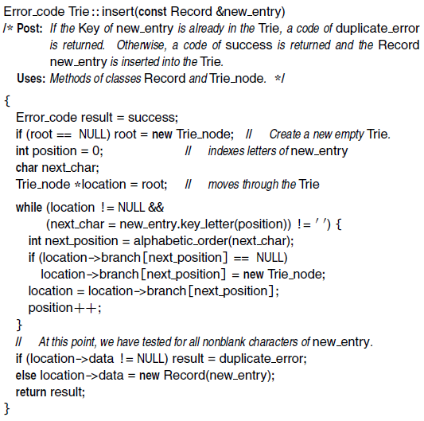
Insertion into a Trie
Note the Trie_node constructor

Slide 20
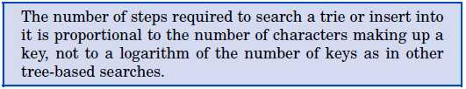
Trie
A common application of a trie is storing a predictive text or autocomplete dictionary, such as found on a mobile telephone. Such applications take advantage of a trie’s ability to quickly search for, insert, and delete entries.

Slide 21
Splay Trees*: A Self-Adjusting Data Structure
In some applications, we wish to keep records that are newly inserted or frequently accessed very close to the root, while records that are inactive may be placed far off, near or in the leaves.
We make a binary search tree into a self-adjusting data structure that automatically changes its shape to bring records closer to the root as they are more frequently accessed, allowing inactive records to drift slowly out toward the leaves.
In a splay tree, every time we access a node, whether for insertion or retrieval, we lift the newly-accessed node all the way up to become the root of the modified tree.
We use rotations like those of AVL trees, but now with many rotations done for every insertion or retrieval in the tree.

Slide 22
Splay Rotations
We move the target node two levels up the tree at each step.
Consider the path going from the root down to the accessed node.
  If we move left, we say that we zig.
  If we move right we say that we zag.
  A move of two steps left (going down) is called zig-zig.
  A move of two steps right is called zag-zag.
  Left then right: zig-zag
  Right then left: zag-zig.
If the length of the path is odd, either a single zig move or a zag move occurs at the end.

Slide 23
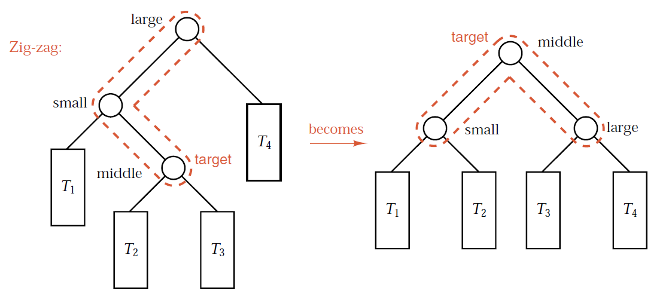
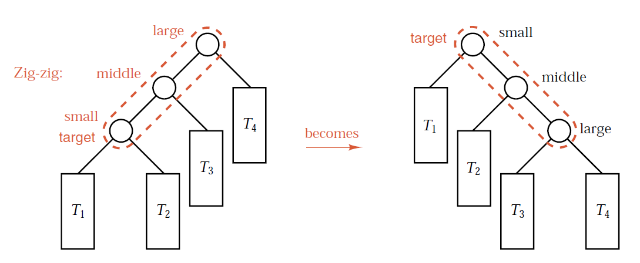
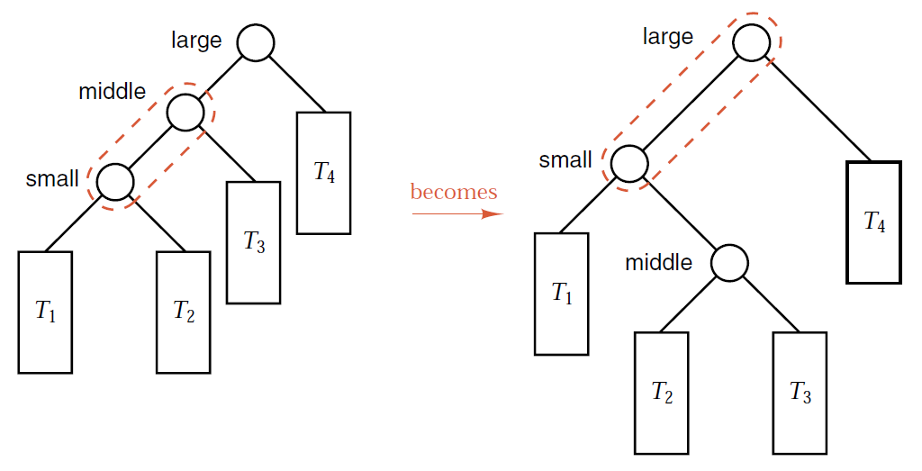
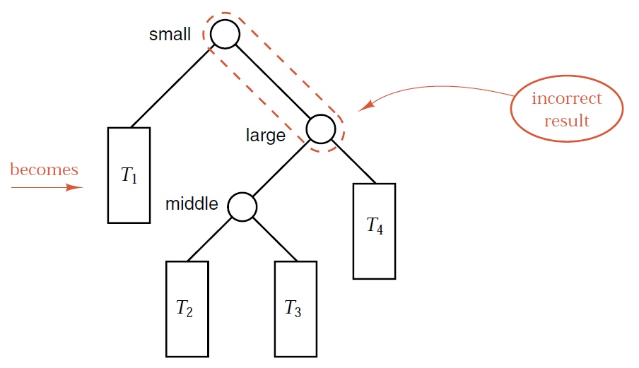
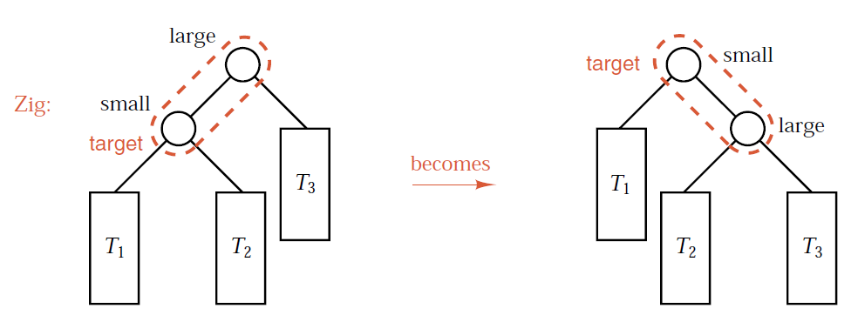
Splay Rotations
The zig-zag case is identical to that of an AVL double rotation.
The zig case is identical to a single rotation.
The zig-zig case is not the same as would be obtained by lifting the target node twice with single rotations (see bottom example).
  It should be lifting the middle node first, then the small (target) node next
Always think of lifting the target two levels at a time (except for a single zig or zag step at the end).

Slide 24
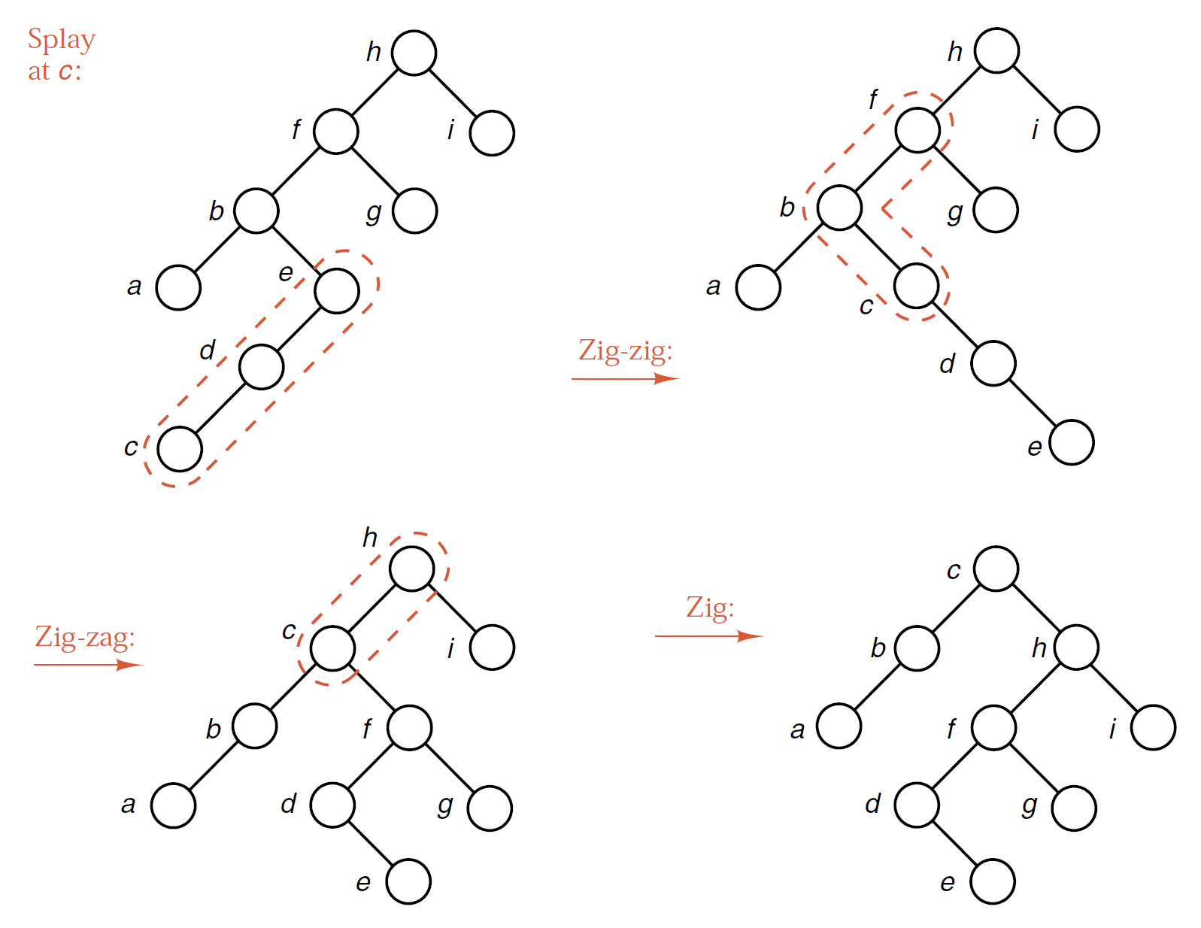
Example

Slide 25
Top-Down and Bottom-Up Splaying
By hand, we perform bottom-up splaying, beginning at the target node and moving up the path to the root two steps at a time. A single zig or zag move may occur at the top of the tree.
Bottom-up splaying is essentially a two-pass method, first searching down the tree and then splaying the target up to the root.
In a computer algorithm, we splay from the top-down while we are searching for the target node. When we find the target, it is immediately moved to the root of the tree, or, if the search is unsuccessful, a new root is created that holds the target. In top-down splaying, a single zig or zag move occurs at the bottom of the splaying process.
If you run the splaying function we develop on the example trees, you will obtain the same results as doing bottom-up splaying by hand when the target is moved an even number of levels, but the results will be different when it moves an odd number of levels.

Slide 26
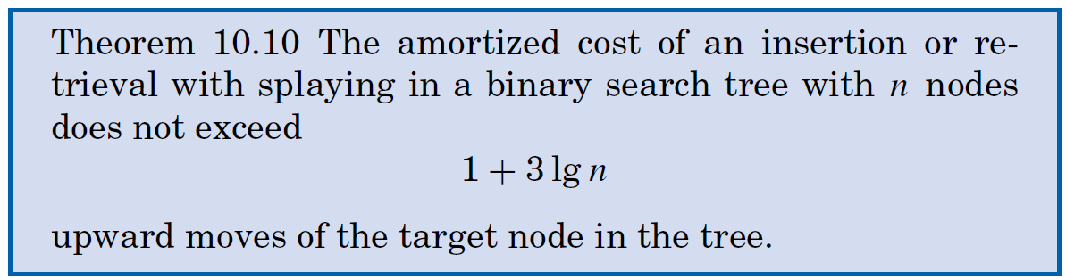
Complexity of Splaying
The fact that insertions and retrievals in a splay tree, over a long sequence, are guaranteed to take only O(log n) time.
At any time, it is quite possible for a splay tree to degenerate into a highly unbalanced shape.

Slide 27
Splay Tree
https://www.bilibili.com/video/BV1py4y1a7v8

Slide 28

Thank you!

